Slide 1
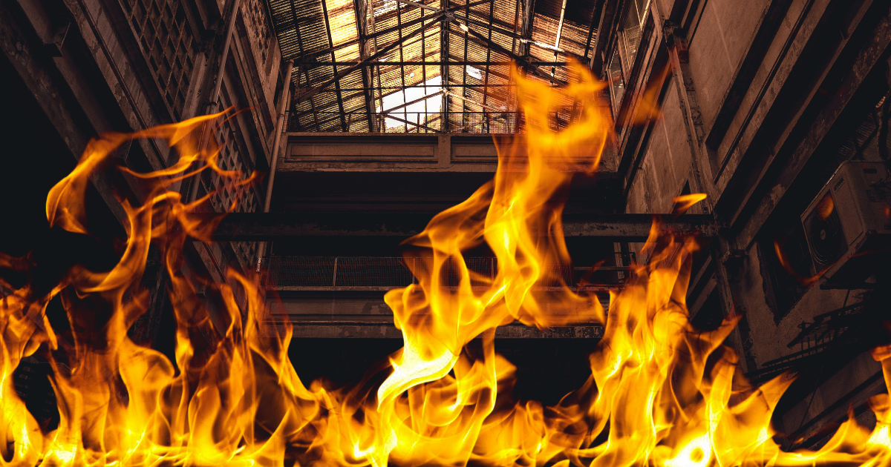

Fire design
NOB021
doc. Ing. Martin Vild, Ph.D.
4/2026

Slide 2



Prezentuje
doc. Ing. Martin Vild, Ph.D.
IDEA StatiCa – Product Owner
VUT FAST – Docent
Výzkum:
Přípoje ocelových konstrukcí
Metoda konečných prvků
Scopus Author ID: 56188615700
Člen komisí:
CEN/TC 250/SC 3/WG 8 "Evolution of EN 1993-1-8 - Joints and connections“
ECCS TC10 “Structural Connections”
Web:
https://www.fce.vutbr.cz/KDK/vild.m/
email: martin.vild@vutbr.cz
Kancelář: C203

Slide 3
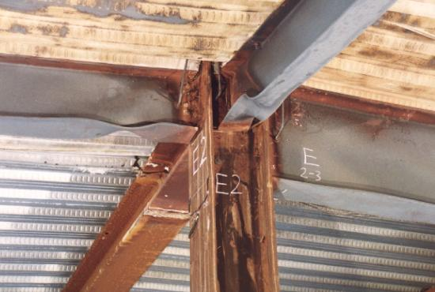
Contents
Introduction:
Design codes
Accidental situation
Concepts
Fire curves
Material properties
Fire protection
Steel temperature

Slide 4
Design codes
EN 1991-1-2 (thermal actions)
EN 1993-1-2 – Eurocode 3: Design of steel structures - Part 1-2: General rules - Structural fire design
EN 1992-1-2 (concrete), EN 1994-1-2 (composite), EN 1995-1-2 (timber)
Building regulations (compartments, escape routes, fire walls)
Standard prescriptive
Simple
For standard design cases
Neglects:
System response
Connections
Thermal stresses (elongation/shrinkage)
Performance-based
Where standard prescriptive does not make sense (train/bus station…)
Attempt to model:
Real fire hazards
Actual building response
Specified performance
Time-consuming design
Economic, safe

Slide 5
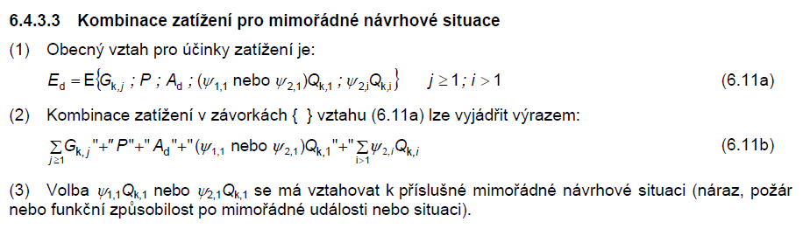

Accidental load
Safety factor $γ_{M,fi}=1,0$
Often explosion + fire or crash + fire
Static loads – simplified:

Slide 6
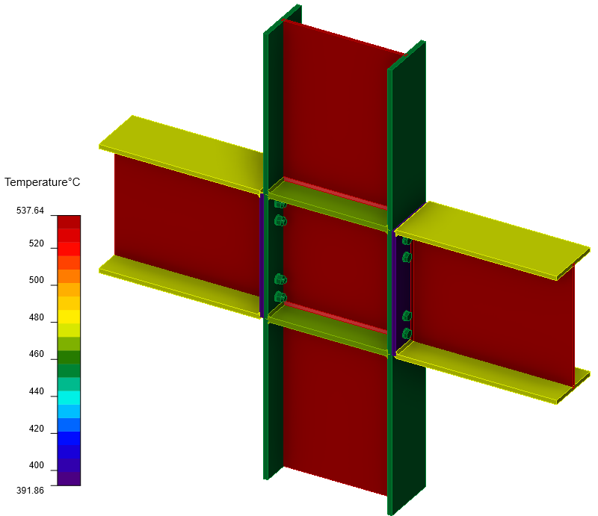
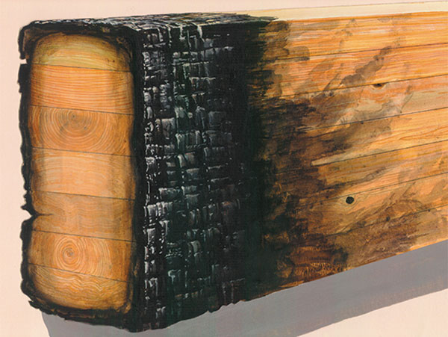
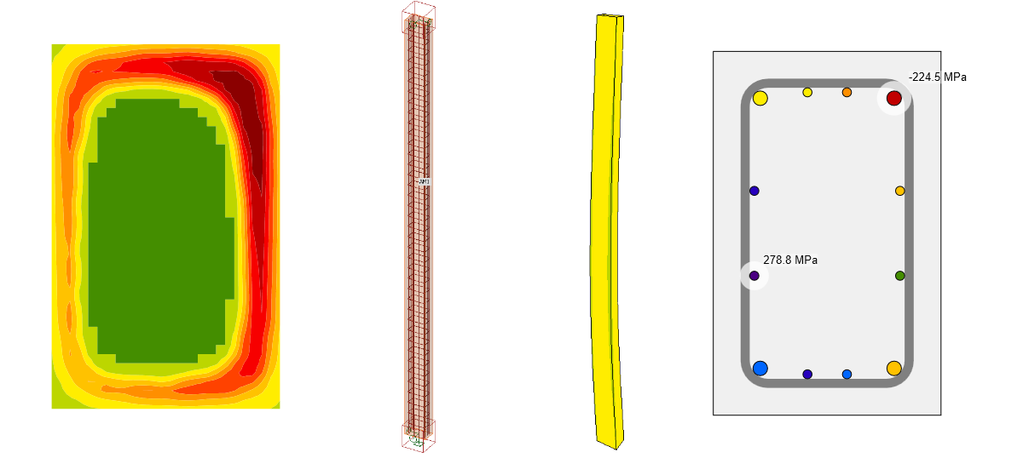
Weakening concepts
Steel – whole plate or member
Timber – charring around
Heavy/light
Concrete – from around, high mass, reinforcement

Slide 8
Concept
Passive/active fire protection
Compartmentalization
People must escape first
Firefighters are safe while fighting the fire
Building collapses inside
Surrounding buildings do not catch fire

Slide 9
Concept
There are many ways how to deal with fire safety:
People escape very fast (e.g., UK)
Building lasts long during fire (e.g., CZ)
Fire protection (impact on environment and schedule)
A lot of mass (larger beams than needed for SLS+ULS)

Slide 10
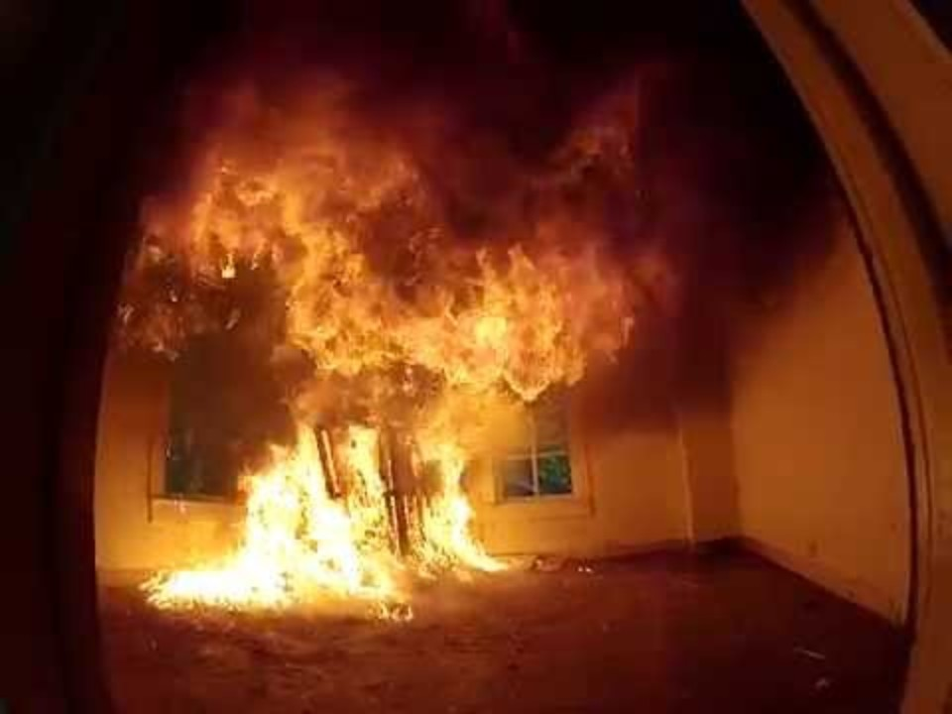
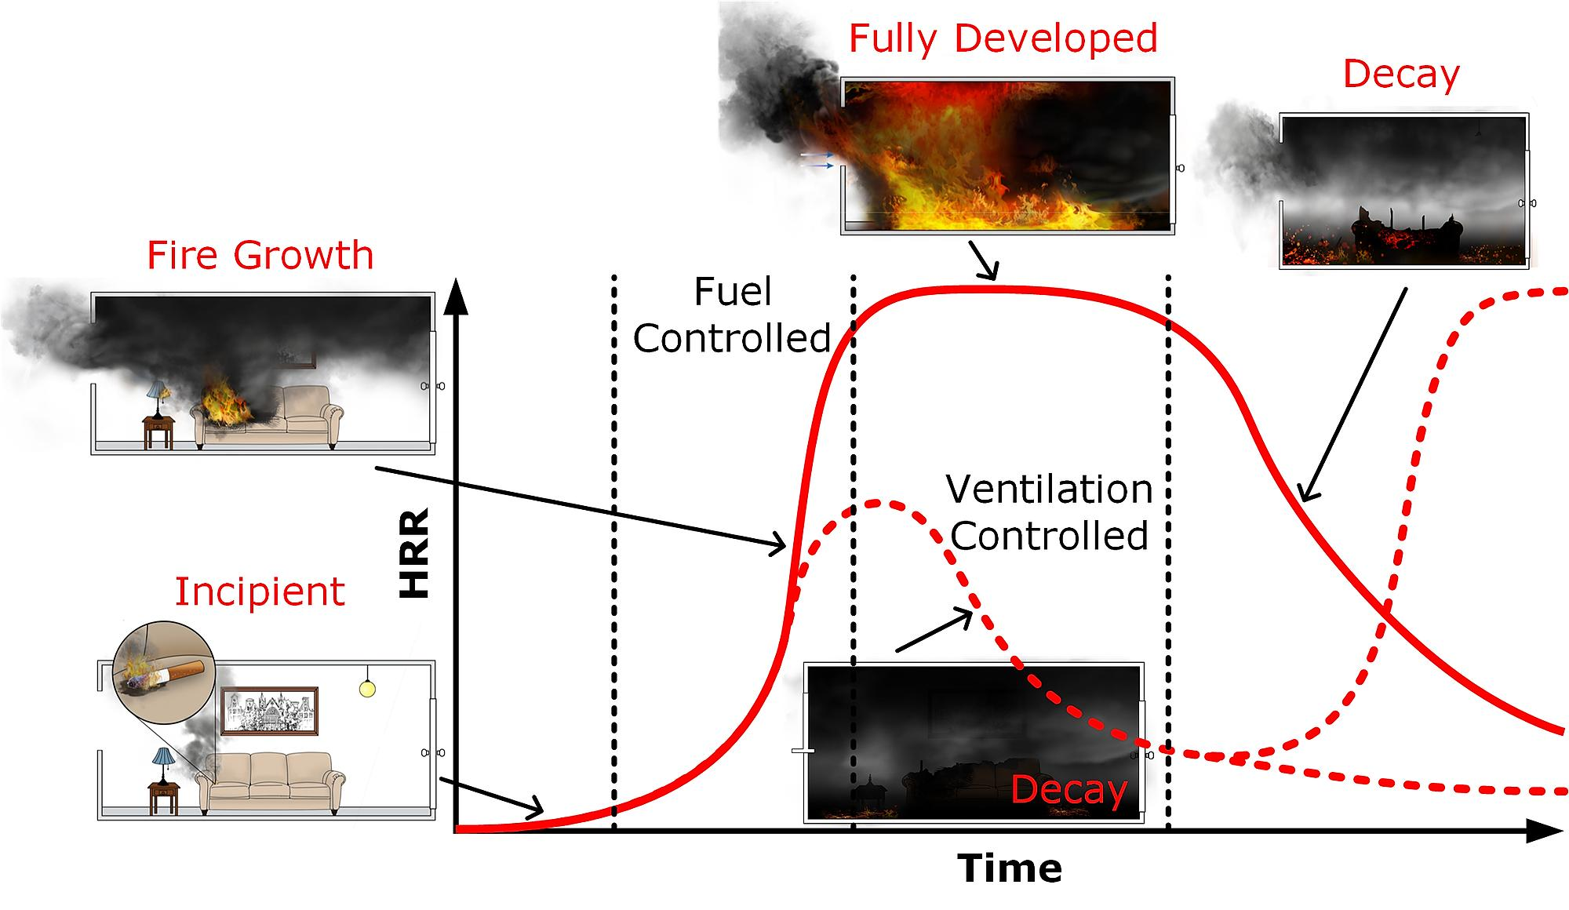
Fire stages
Ignition (Sprinklers)
Growth
Flashover
Fully-developed fire
Decay
ISO

Slide 11
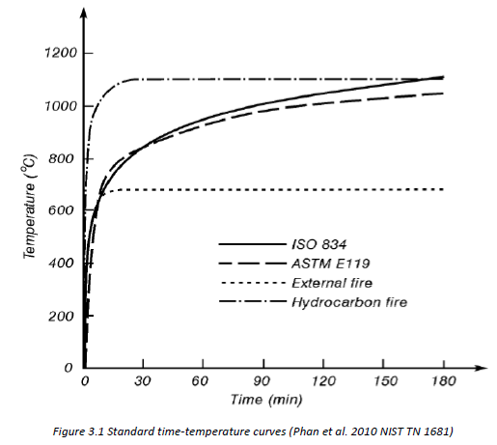
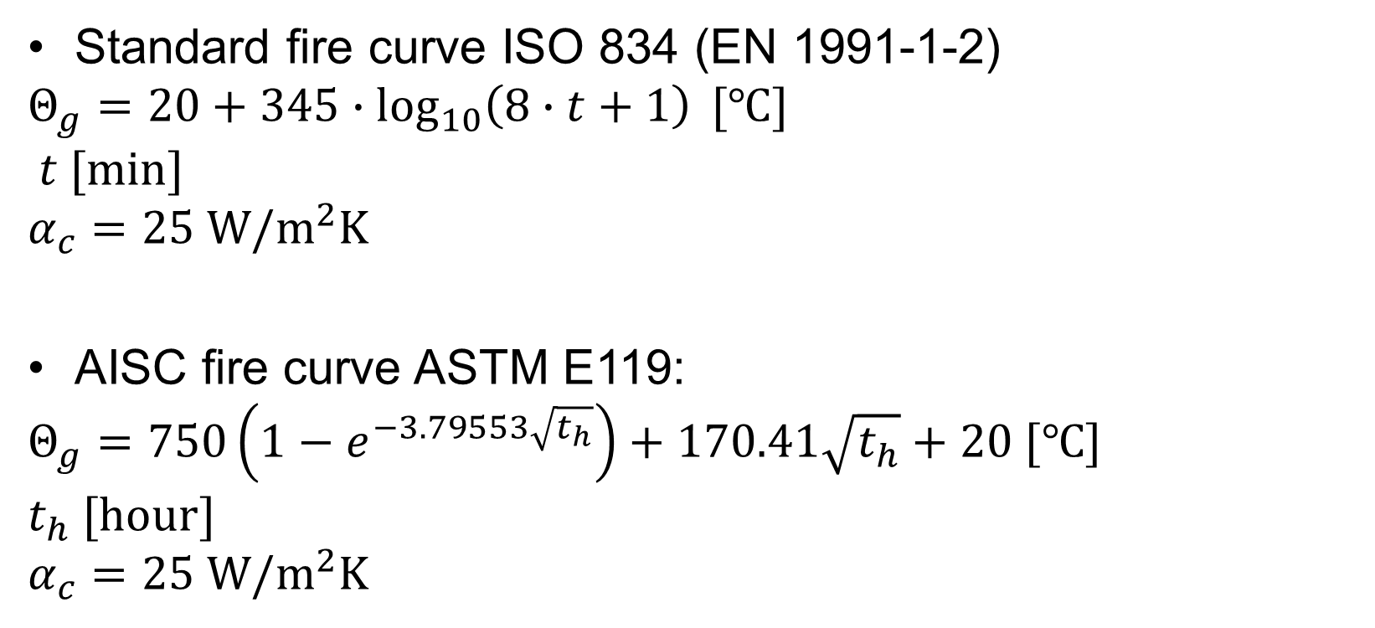
Fire curves
Standard fire curve ISO 834 (EN 1991-1-2)
$$Θ_{g}=20+345∙\log_{10}\left(8∙t+1\right) [℃]$$
$$t [min]$$
$$α_{c}=25 W/m^{2}K$$
AISC fire curve ASTM E119:
$$Θ_{g}=750\left(1−e^{−3.79553\sqrt{t_{h}}}\right)+170.41\sqrt{t_{h}}+20 [℃]$$
$$t_{h} [hour]$$
$$α_{c}=25 W/m^{2}K$$

Slide 12
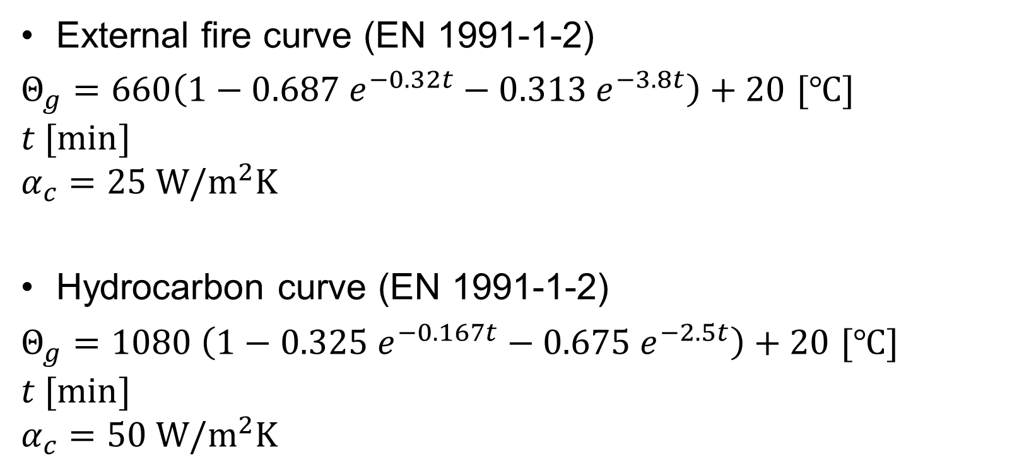
Fire curves
External fire curve (EN 1991-1-2)
$Θ_{g}=660\left(1−0.687 e^{−0.32t}−0.313 e^{−3.8t}\right)+20$ $[℃]$
$$t [min]$$
$$α_{c}=25 W/m^{2}K$$
Hydrocarbon curve (EN 1991-1-2)
$Θ_{g}=1080 \left(1−0.325 e^{−0.167t}−0.675 e^{−2.5t}\right)+20$ $[℃]$
$$t [min]$$
$$α_{c}=50 W/m^{2}K$$

Slide 13
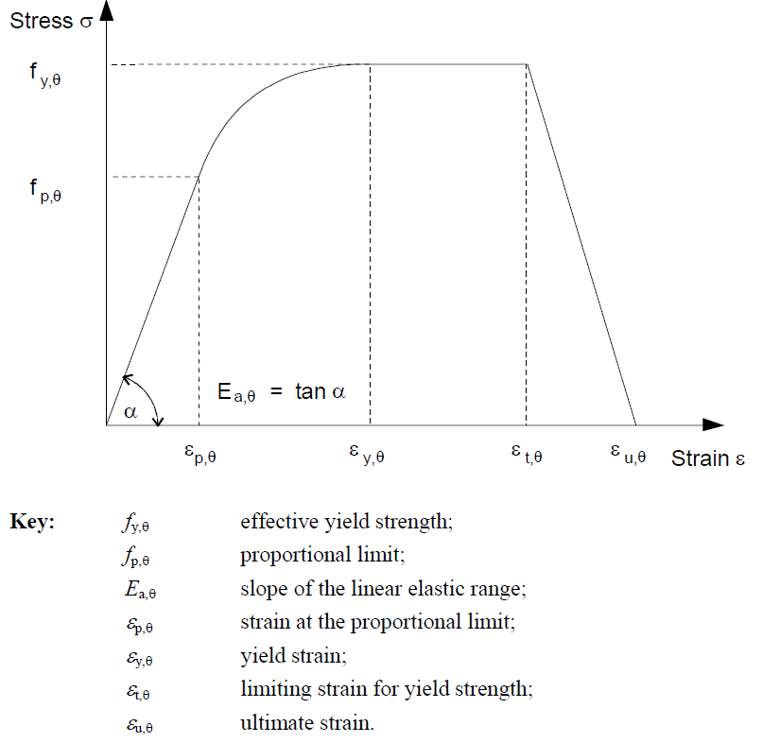
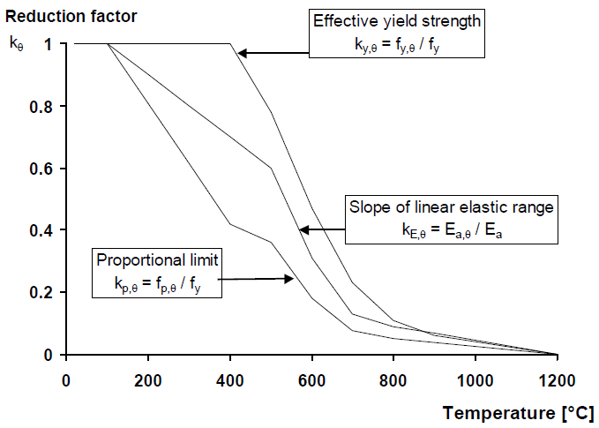
Material properties – Steel

Slide 14
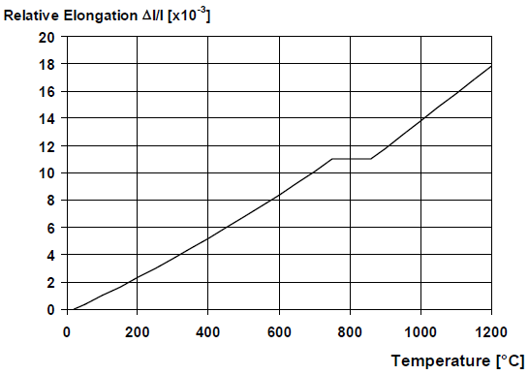
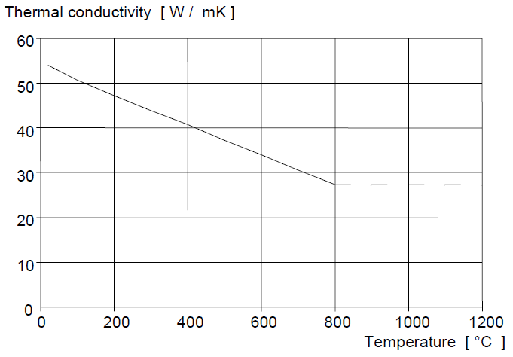
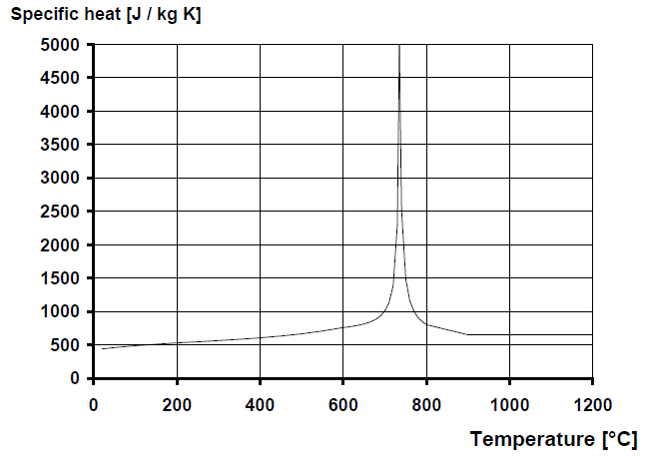
Material properties – Steel
Phase transformation
Melts at about 1450 ˚C

Slide 15
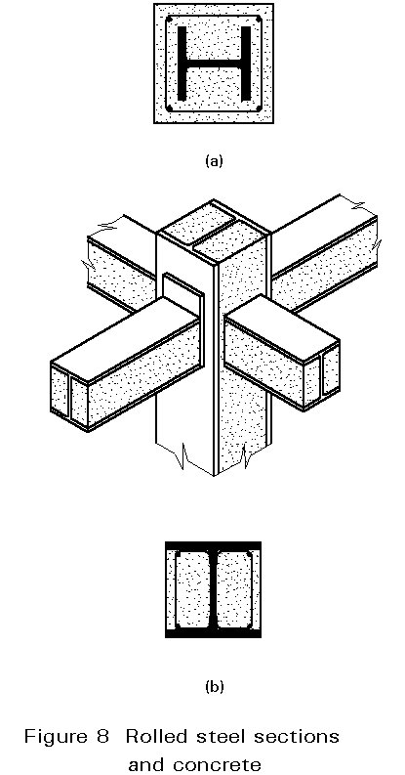
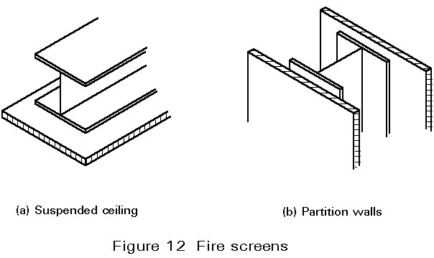
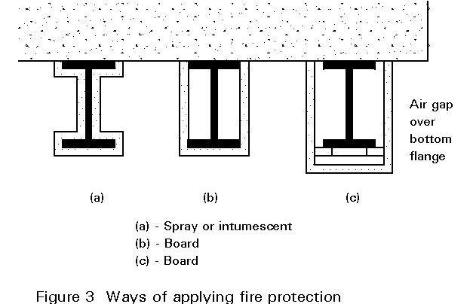
Fire protection
https://fgg-web.fgg.uni-lj.si/~/pmoze/esdep/master/wg04b/l0400.htm

Slide 16
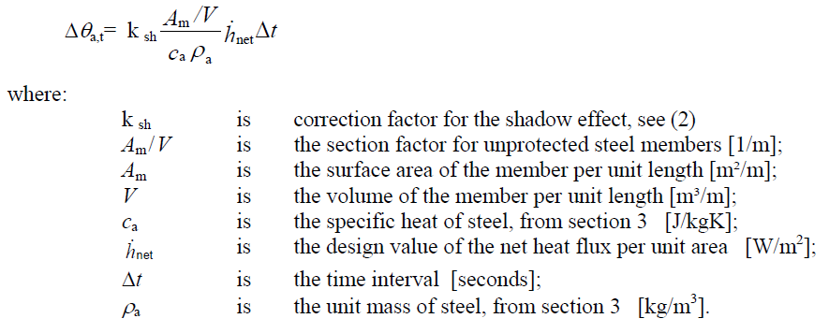
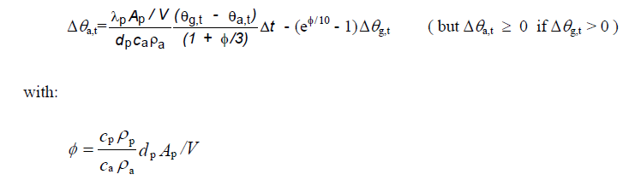
Temperature
Unprotected internal steelwork
Internal steelwork insulated by fire protection material

Slide 17
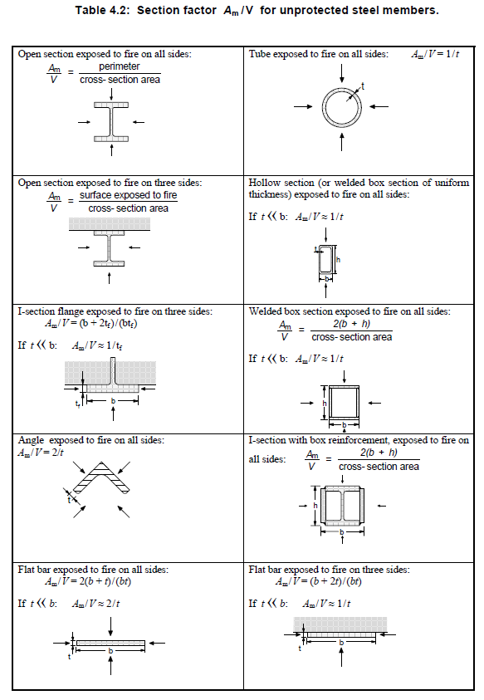
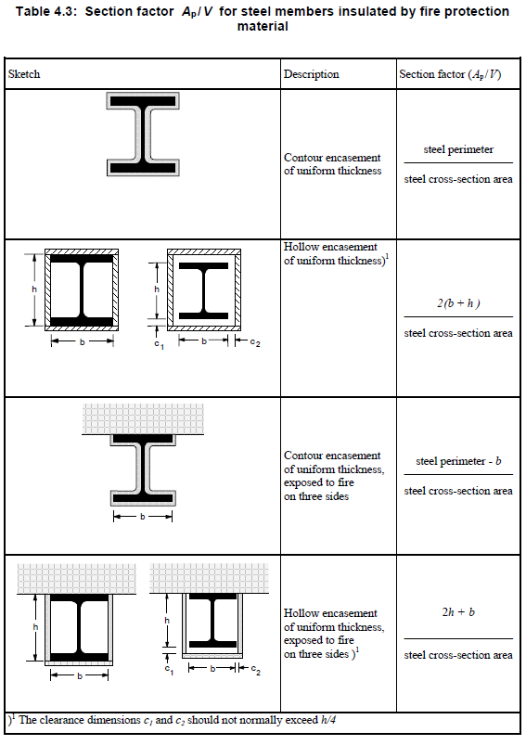
Temperature

Slide 18
Design workflow
Time classes – 15, 30, 45, 60…240 min (EN 13501-2)
Fire curves
Loading (accidental)
Temperature of air → temperature of steel
Reduce material properties
Calculate resistances
Increase sizes / add fire protection / add restraints

Slide 19
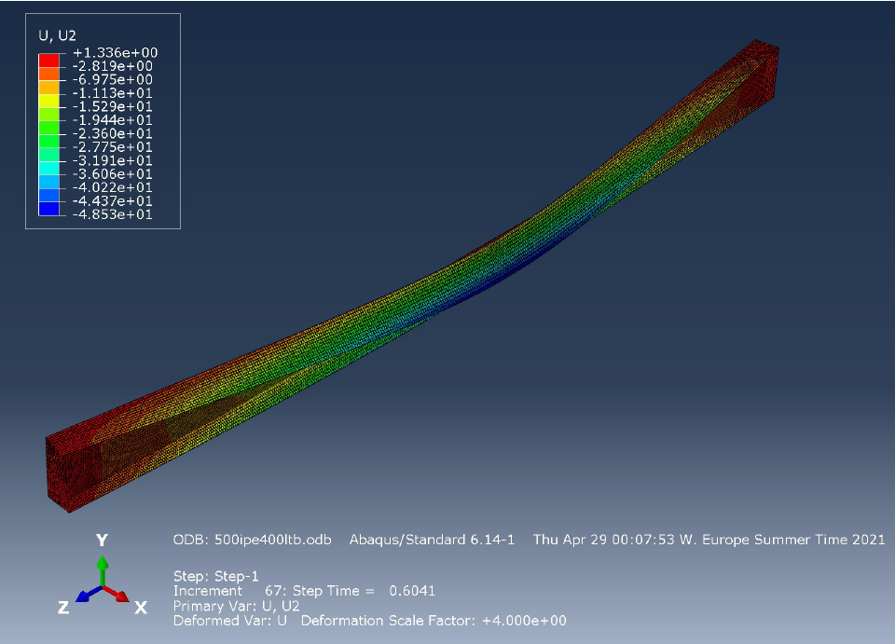
Beam – verification
Buckling! E dropping fast

Slide 20
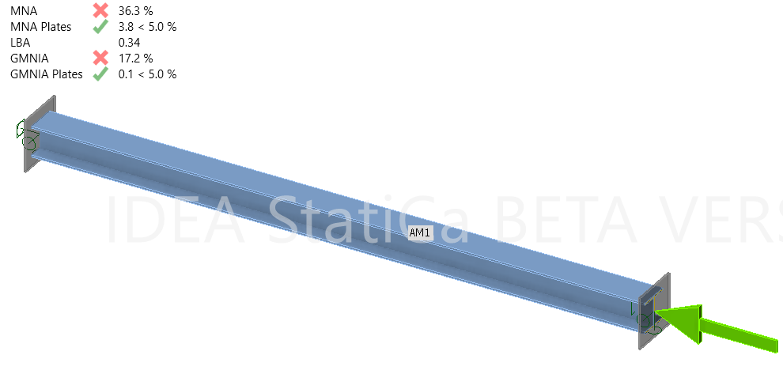
Column – verification
Length L (m) | HEB 300 - PP - 600°C |  | Boundary conditions | HEB 300 - 6 m - 500°C
 | AM | CBFEM |  | AM | CBFEM
4 | 1129 | 1020 | PP | 1347 | 1238
6 | 737 | 660 | FP | 1915 | 1742
7 | 596 | 550 | FF | 2334 | 2226

Slide 21
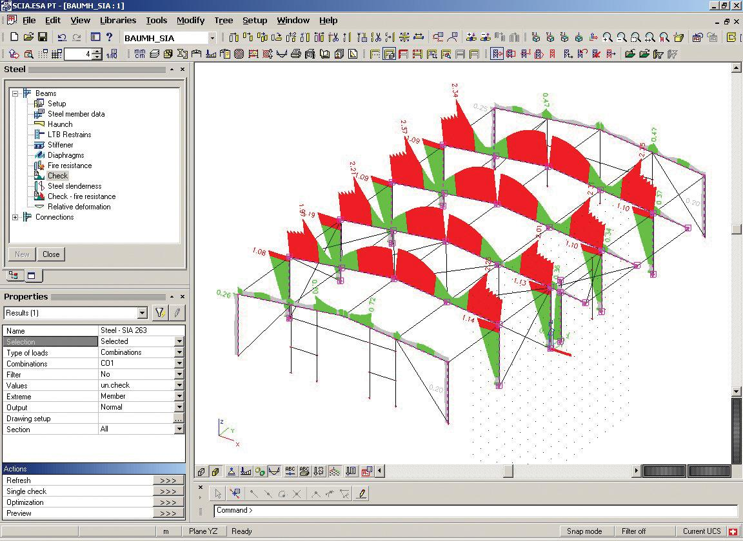
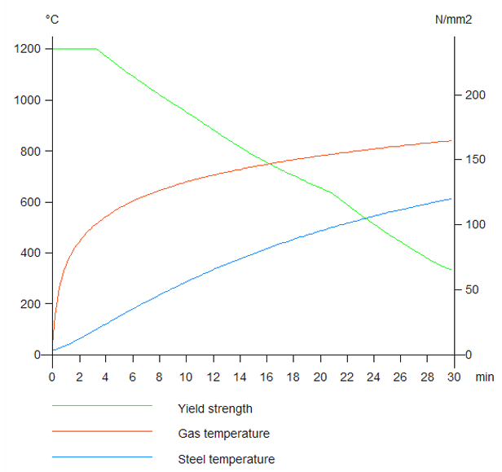
Member design
https://www.scia.net/en/scia-engineer/fact-sheets/steel-design/sensd05-steel-fire-resistance-design

Slide 22
Task 1
Calculate the buckling resistance of simply supported column HEA 200 with the length of 3 m at 15 min of standard fire curve in:
SCIA Engineer or Dlubal using code calculations
IDEA StatiCa Member using GMNIA

Slide 23
Connections
Temperature of steel plates = temperature of bolts or welds
Safe assumption (there is more material, slower heating)
Loading:
Heating = expansion
Cooling = shrinkage – may be governing – large tensile forces in the members, which elongate and then shrink

Slide 24
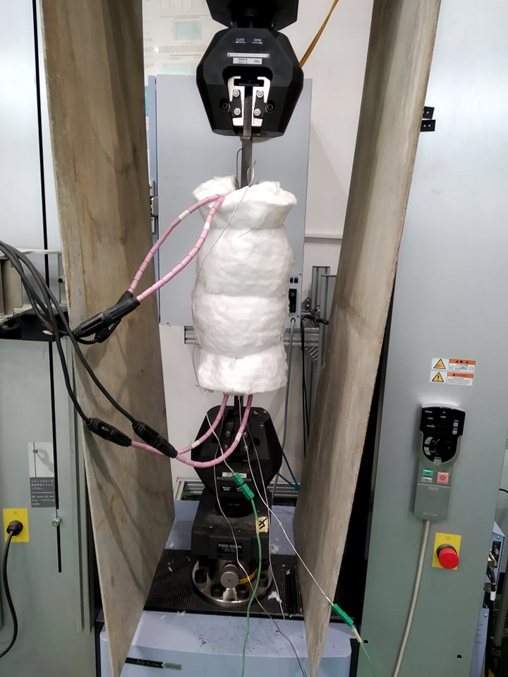
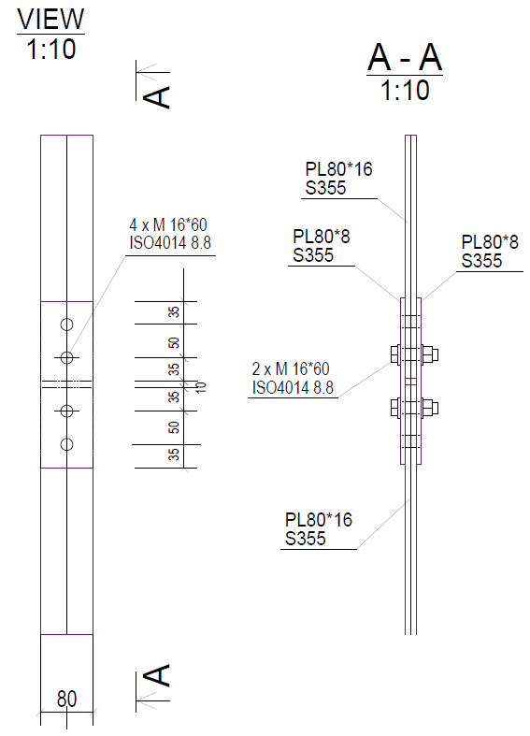
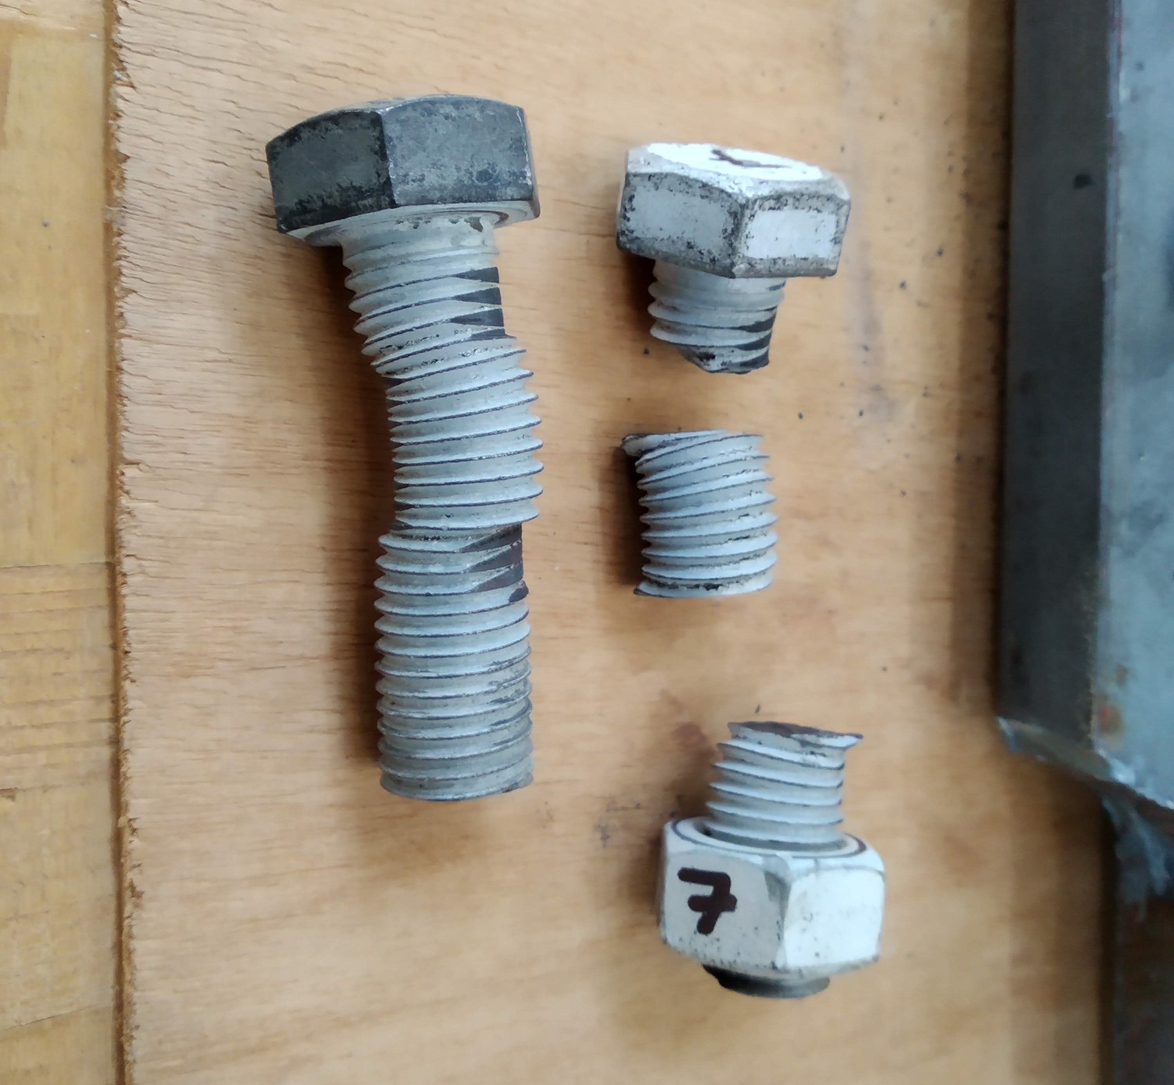
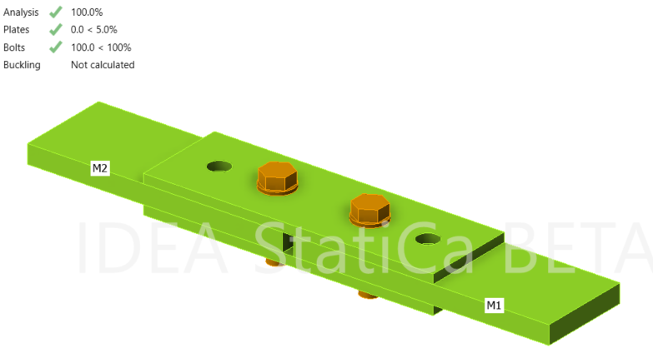
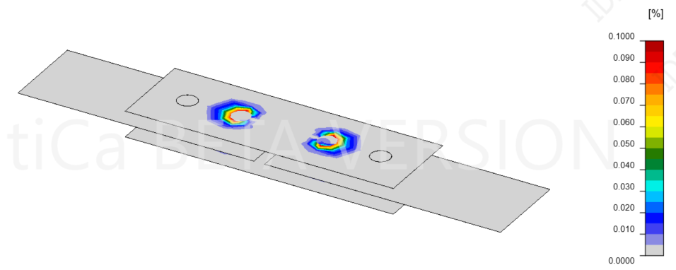
Connections – validation
Specimen | θ (°C) | Experiment |  |  | Eurocode
 |  | Failure Loads [kN] | Mean Resistance [kN] | Failure Mode | Resistance [kN] | Failure Mode
Test 1 | 20 | 297.8 | 297.8 | Bolts in shear | 241.2 | Bolts in shear
Test 2 |  | 146.7 | 148.4 | Bolts in shear | 120.6 | Bolts in shear
Test 3 |  | 150.1
Test 4 | 400 | 106.4 | 110.8 | Bolts in shear | 93.6 | Bolts in shear
Test 5 |  | 122.6
Test 6 |  | 103.4
Test 7 | 600 | 36.7 | 32.7 | Bolts in shear | 26.9 | Bolts in shear
Test 8 |  | 33.9
Test 9 |  | 27.5

Slide 25
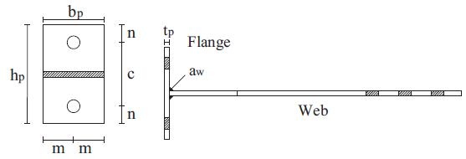
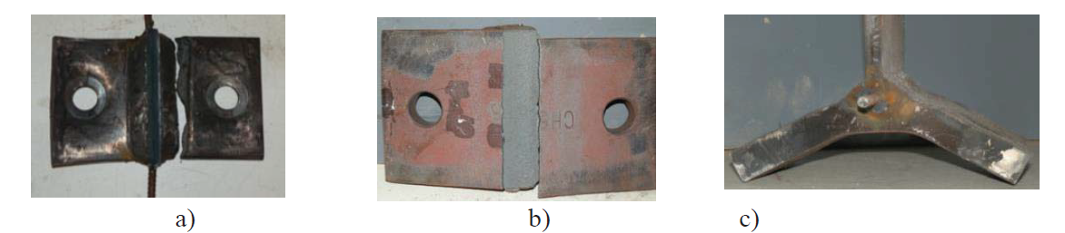
Connections – validation
a) T-10-600; b) T-15-500; c) T-20-500

Slide 26
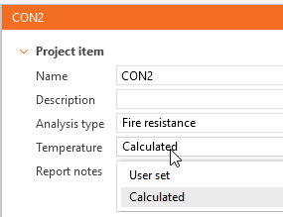
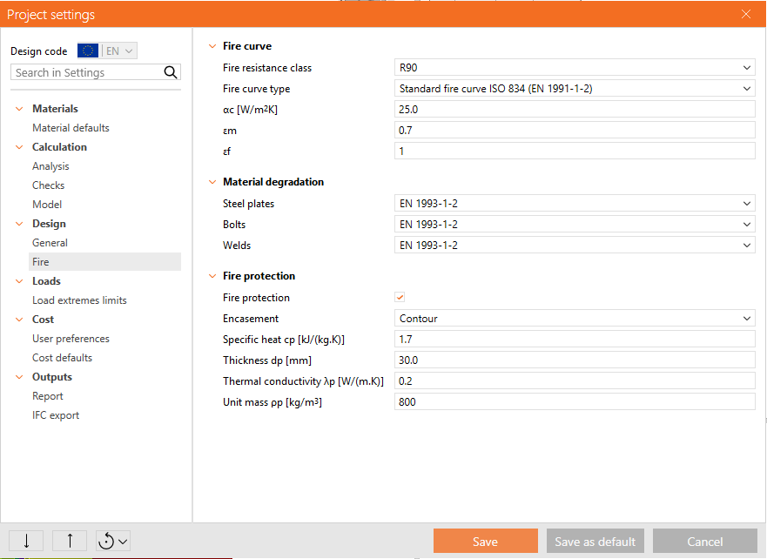
IDEA StatiCa Connection

Slide 27
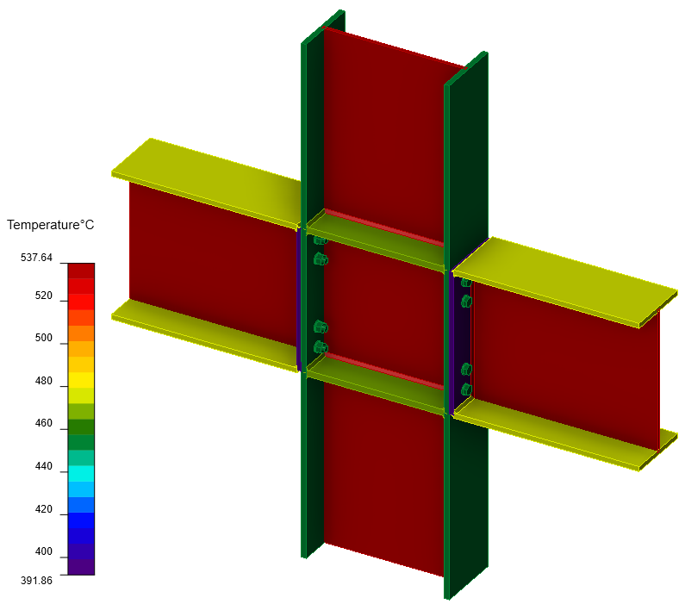
IDEA StatiCa Connection
Bolts and welds have the temperature of the hotter connected plate

Slide 28
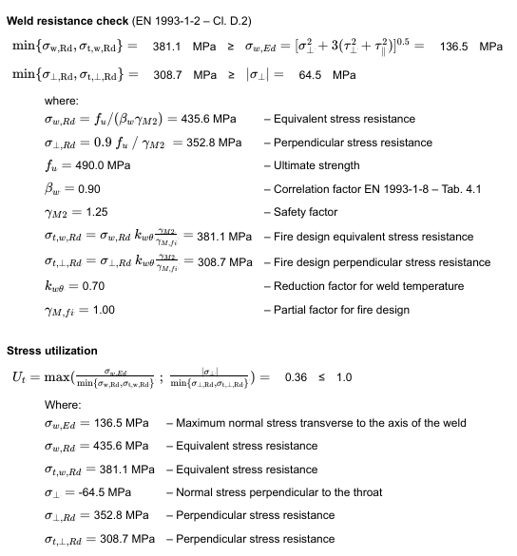
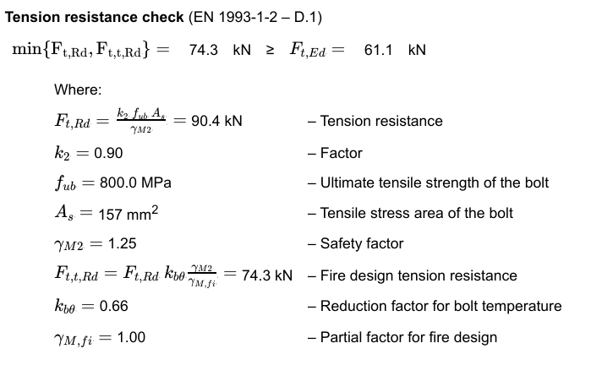
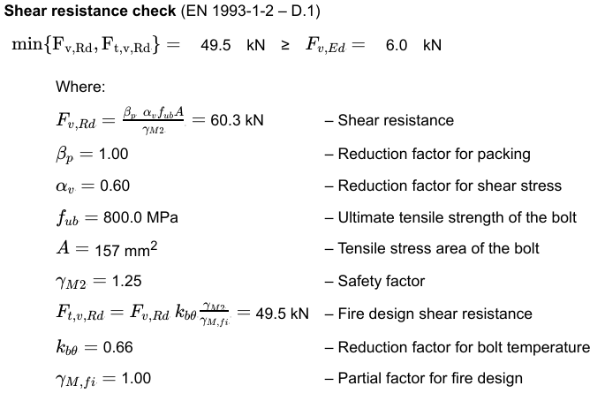
IDEA StatiCa Connection
Perhaps too safe (accidental design situation)

Slide 29
Task 2
Design an end plate beam-to-column connection to resist 60% of beam bending resistance (ULS).
Design a fire protection, so that the connection resists 70% of the original load for time class R90.
Design members and connection, so that no fire protection is needed for R30 for the same load.

Slide 30
Further reading
https://fgg-web.fgg.uni-lj.si/~/pmoze/esdep/master/wg04b/toc.htm
https://people.fsv.cvut.cz/~wald/fire/ifer/benchmark/index.htm
https://eurocodes.jrc.ec.europa.eu/sites/default/files/2022-06/03a-VASSART-EC-FireDesign-WS.pdf

